Slide 1
Module No. 1 Introduction to NLP
LECTURE 1

Slide 2
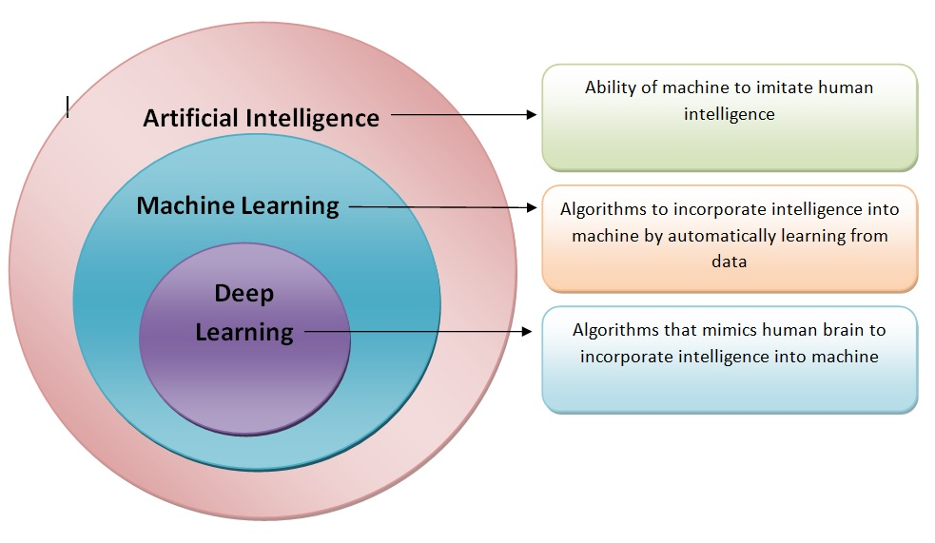

Slide 3
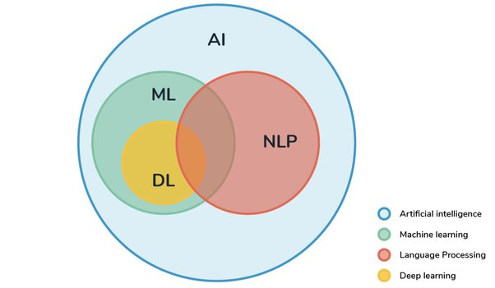

Slide 4
Introduction
What is Natural Language Processing?
Why NLP for Machines?
Why NLP?
History of NLP?

Slide 5
Motivation for NLP
Understand language analysis & generation
Communication
Language is a window to the mind
Data is in semantic form
Data can be Structured (table form), Semi-structured (XML form), or Unstructured (sentence form).

Slide 6
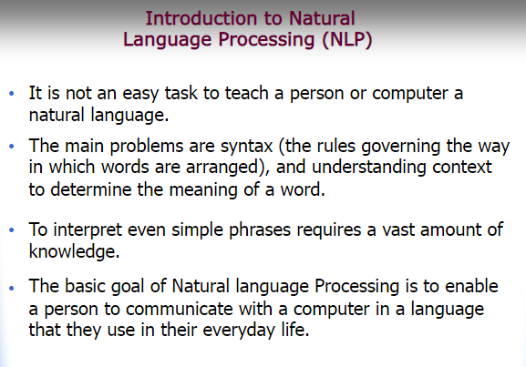

Slide 7
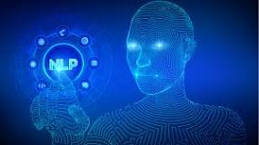
Natural language processing (NLP) is a branch of artificial intelligence within computer science that focuses on helping computers to understand the way that humans write and speak.
Natural language processing (NLP) refers to the branch of computer science—and more specifically, the branch of artificial intelligence or AI—concerned with giving computers the ability to understand text and spoken words in much the same way human beings can.

Slide 8
What is Natural Language Processing?
It is used to process information contained in natural language text
Also known as Computational Linguistics (CL),
Human Language Technology (HLT),
Natural Language Engineering
Natural language processing helps computers communicate with humans in their own language and scales other language-related tasks.
For example, NLP makes it possible for computers to read text, hear speech, interpret it, measure sentiment and determine which parts are important.

Slide 9
How NLP is used in AI?
NLP enables computers to understand natural language as humans do. Whether the language is spoken or written, natural language processing uses artificial intelligence to take real-world input, process it, and make sense of it in a way a computer can understand..
Natural Language Processing (NLP) allows machines to break down and interpret human language. It's at the core of tools we use every day – from translation software, chatbots, spam filters, and search engines, to grammar correction software, voice assistants, and social media monitoring tools.

Slide 10
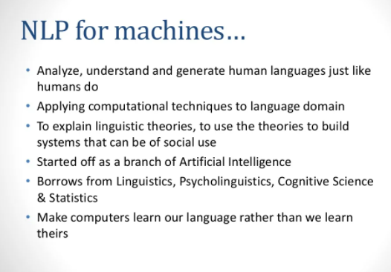

Slide 11
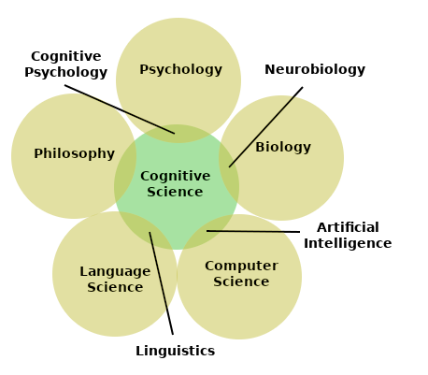

Slide 12
Why is NLP today important?
NLP is important because it helps resolve ambiguity in language and adds useful numeric structure to the data for many downstream applications, such as speech recognition or text analytics
How NLP is changing the world?
NLP has been used in applications such as voice recognition, speech recognition, speech synthesis, text-to-speech systems, machine translation, information retrieval and summarization. Machines and humans continue to collaborate and learn from each other.

Slide 13
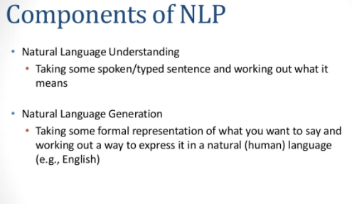

Slide 14
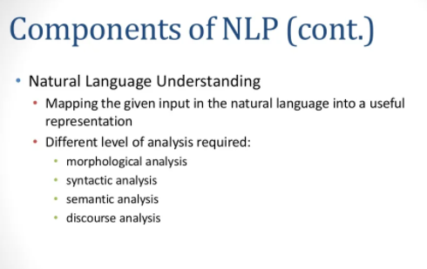

Slide 15
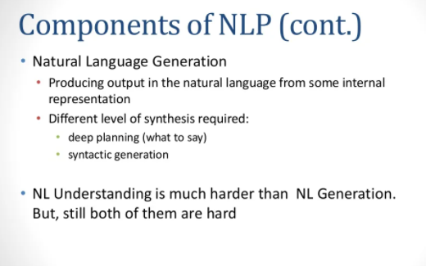

Slide 16
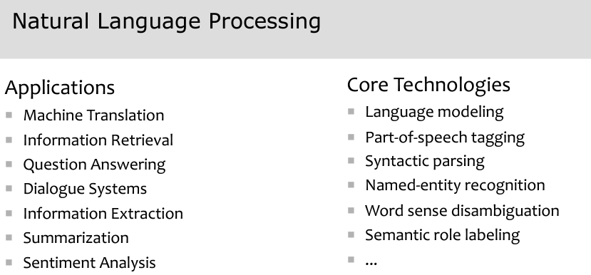

Slide 17
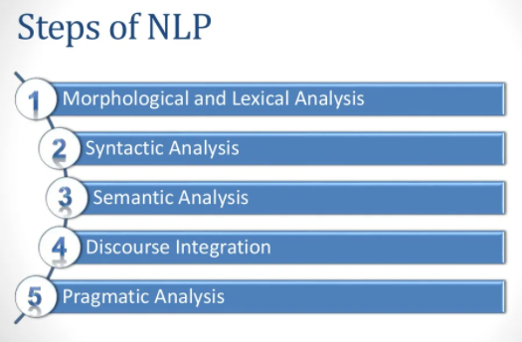

Slide 18
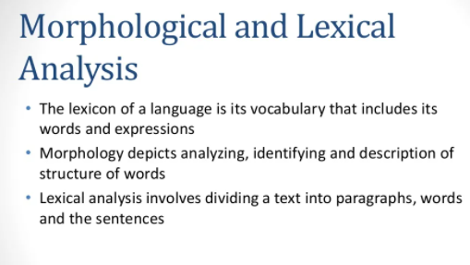

Slide 19
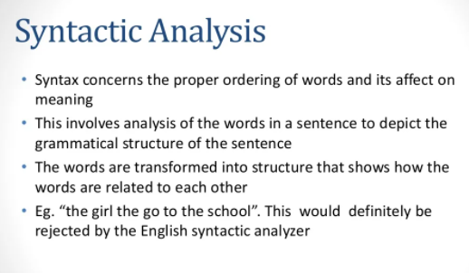

Slide 20
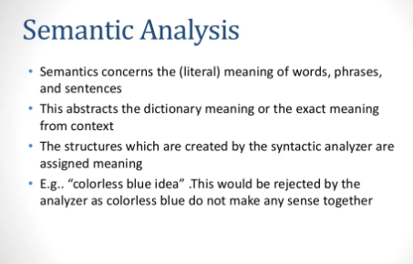

Slide 21
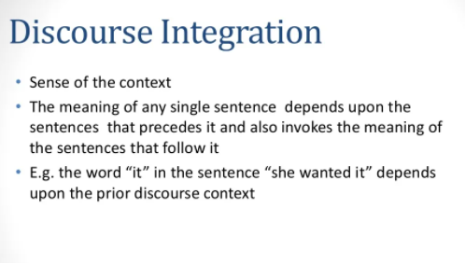

Slide 22
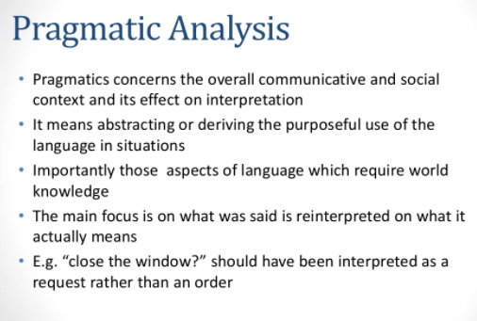

Slide 23
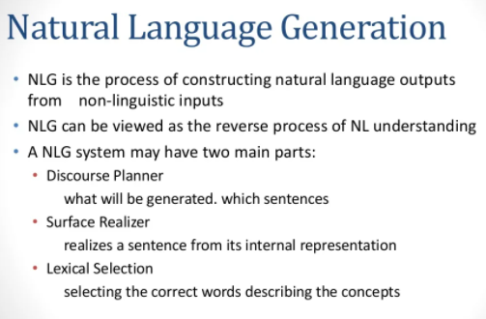

Slide 24
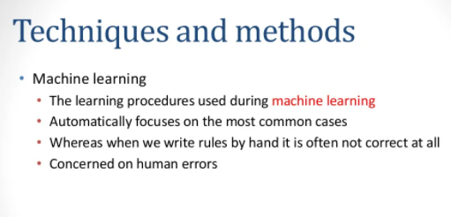

Slide 25
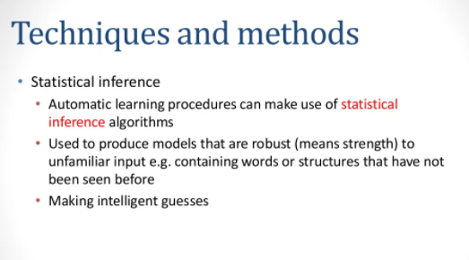

Slide 26
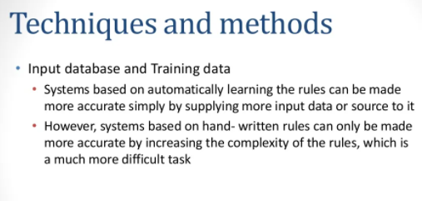

Slide 27
Text Wrangling
Text cleansing
Sentence splitter
Tokenization
Stemming
Lemmatization
Stop word removal
Rare word removal
Spell correction

Slide 28
Text Wrangling
Wrangling is a process where one transforms “raw” data for making it more suitable for analysis and it will improve the quality of your data.
The process involves data munging, text cleansing, specific preprocessing, tokenization, stemming or lemmatization and stop word removal.
Let's start with a basic example of parsing a csv file:
>>>import csv
>>>with open('example.csv','rb') as f:
>>> reader = csv.reader(f,delimiter=',',quotechar='"')
>>> for line in reader :
>>> print line[1] # assuming the second field is the raw sting

Slide 29
For example, json looks like:
{
"array": [1,2,3,4],
"boolean": True,
"object": {
"a": "b"
},
"string": "Hello World"
}
Let's say we want to process the string. The parsing code will be:
>>>import json
>>>jsonfile = open('example.json')
>>>data = json.load(jsonfile)
>>>print data['string']
"Hello World“
Python allows you to choose and process it to a raw string form.

Slide 30
Text cleansing
Text cleansing is loosely used for most of the cleaning to be done on text, depending on the data source, parsing performance, external noise and so on.
In Natural Language Processing for cleaning the html using html_clean, can be labeled as text cleansing.
In another case, where we are parsing a PDF, there could be unwanted noisy characters, non ASCII characters to be removed, and so on.
Before going on to next steps we want to remove these to get a clean text to process further.

Slide 31
Sentence splitter
Some of the NLP applications require splitting a large raw text into sentences to get more meaningful information out.
A sentence is an acceptable unit of conversation.
A typical sentence splitter can be something as simple as splitting the string on (.), to something as complex as a predictive classifier to identify sentence boundaries:
>>>inputstring = ' This is an example sent. The sentence splitter will
split on sent markers. Ohh really !!'
>>>from nltk.tokenize import sent_tokenize
>>>all_sent = sent_tokenize(inputstring)
>>>print all_sent
[' This is an example sent', 'The sentence splitter will split on
markers.','Ohh really !!']

Slide 32
We are trying to split the raw text string into a list of sentences.
The function sent_tokenize, internally uses a sentence boundary detection algorithm that comes pre-built into NLTK.
If your application requires a custom sentence splitter, there are ways that we can train a sentence splitter of our own:
>>>import nltk.tokenize.punkt
>>>tokenizer = nltk.tokenize.punkt.PunktSentenceTokenizer()

Slide 33
Tokenization
A word (Token) is the minimal unit that a machine can understand and process. Tokenization is the process of splitting the raw string into meaningful tokens.
>>>s = "Hi Everyone ! hola gr8" # simplest tokenizer
>>>print s.split()
['Hi', 'Everyone', '!', 'hola', 'gr8']
>>>from nltk.tokenize import word_tokenize
>>>word_tokenize(s)
['Hi', 'Everyone', '!', 'hola', 'gr8']
>>>from nltk.tokenize import regexp_tokenize, wordpunct_tokenize,
blankline_tokenize
>>>regexp_tokenize(s, pattern='\w+')
['Hi', 'Everyone', 'hola', 'gr8']
>>>regexp_tokenize(s, pattern='\d+')
['8']
>>>wordpunct_tokenize(s)
['Hi', ',', 'Everyone', '!!', 'hola', 'gr8']
>>>blankline_tokenize(s)
['Hi, Everyone !! hola gr8']

Slide 34
Stemming
Stemming, in literal terms, is the process of cutting down the branches of a tree to its stem.
With the use of some basic rules, any token can be cut down to its stem.
Stemming is more of a crude rule-based process by which we want to
club together different variations of the token.
For example, the word eat will have variations like eating, eaten, eats, and so on.
http://www.nltk.org/api/nltk.stem.html
In the following snippet, we show a few stemmers:
>>>from nltk.stem import PorterStemmer # import Porter stemmer
>>>from nltk.stem.lancaster import LancasterStemmer
>>>from nltk.stem.Snowball import SnowballStemmer
>>>pst = PorterStemmer() # create obj of the PorterStemmer
>>>lst = LancasterStemmer() # create obj of LancasterStemmer
>>>lst.stem("eating")
eat
>>>pst.stem("shopping")
shop

Slide 35
Lemmatization
Lemmatization is a more methodical way of converting all the grammatical/inflected forms of the root of the word.
Lemmatization uses context and part of speech to determine the inflected form of the word and applies different normalization rules for each part of speech to get the root word (lemma)
>>>from nltk.stem import WordNetLemmatizer
>>>wlem = WordNetLemmatizer()
>>>wlem.lemmatize("ate")
Eat
Here, WordNetLemmatizer is using wordnet, which takes a word and searches
wordnet, a semantic dictionary. It also uses a morph analysis to cut to the root and search for the specific lemma (variation of the word). Hence, in our example it is possible to get eat for the given variation ate, which was never possible with stemming.

Slide 36
Stop word removal
Stop word removal is one of the most commonly used preprocessing steps across different NLP applications.
The idea is simply removing the words that occur commonly across all the documents in the corpus.
Typically, articles and pronouns are generally classified as stop words. These words have no significance in some of the NLP tasks like information retrieval and classification, which means these words are not very discriminative.
To implement the process of stop word removal, below is code that uses NLTK stop word.
>>>from nltk.corpus import stopwords
>>>stoplist = stopwords.words('english') # config the language name
# NLTK supports 22 languages for removing the stop words
>>>text = "This is just a test"
>>>cleanwordlist = [word for word in text.split() if word not in
stoplist]
# apart from just and test others are stopwords
[‘test']

Slide 37
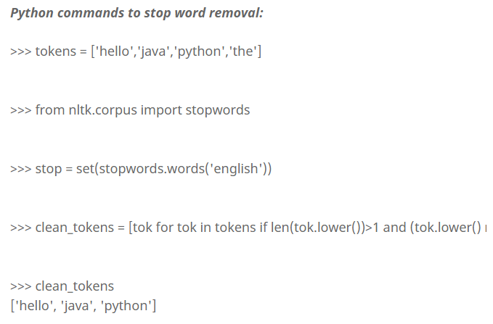

Slide 38
Rare word removal
This is very intuitive, as some of the words that are very unique in nature like names, brands, product names, and some of the noise characters, such as html leftouts, also need to be removed for different NLP tasks.
For example, it would be really bad to use names as a predictor for a text classification problem, even if they come out as a significant predictor.
We also use length of the words as a criteria for removing words with very a short length or a very long length:
>>># tokens is a list of all tokens in corpus
>>>import nltk
>>>tokens= ['hi','i','am','am','whatever','this','is','just','a','test','test','java','python','java']
>>>freq_dist = nltk.FreqDist(token)
>>>rarewords = freq_dist.keys()[-50:]
>>>after_rare_words = [ word for word in token not in rarewords]

Slide 39
Spell correction
It is not a necessary to use a spellchecker for all NLP applications, but some use cases require you to use a basic spell check. We can create a very basic spellchecker by just using a dictionary lookup. There are some enhanced string algorithms that have been developed for fuzzy string matching. One of the most commonly used is edit-distance. NLTK also provides you with a variety of metrics module that has edit_distance.
>>>from nltk.metrics import edit_distance
>>>edit_distance("rain","shine")
3
rain → sain (substitution of “s” for “r”)
sain → shin (substitution of “h” for “a”)
shin → shine (insertion of “e” at the end)

Slide 40
https://michael-fuchs-python.netlify.app/2021/06/16/nlp-text-pre-processing-vi-word-removal/

